Slide 1
Sugar maple sap honey bee experiment protocol
(1)Raw sugar maple sap collected and stored at refrigerated temperatures.
(2)Feed raw maple sugar maple sap to overwintering bees in-situ to hive.
(3)repeat (2) above with several viscosities of boiled down maple sugar sap to include a sap that’s boiled down to a specific gravity comparable to nectar.
repeat (2) AND (3) With bees in summer to produce a maple based honey*
Notes:
* Commercialize ! This would be a very expensive product ☺

Slide 2
Honey Bee Sugar maple sap hypothesis
Boiling of sugar maple sap produces many novel phenols and other compounds, some not found in the sap.
Honey bees may very well metabolize sugar maple sap in winter and perhaps in the summer months as well and not produce honey from the raw sap.
We hypothesize that honey bees may produce honey from sap that has higher viscosities or specific gravities from the boiling process, this leads to an interesting question, at what point does the boiling process produce the maple syrup phenols? And what novel chemicals would the honey bees produce from partially processed sap?

Slide 3
http://www.sciencedirect.com/science/article/pii/S1756464611000090
http://pubs.acs.org/doi/abs/10.1021/jf1033398
http://www.mdpi.com/1420-3049/15/7/4572/pdf
http://forums.gardenweb.com/forums/load/bees/msg1113182225132.html
http://www.wipo.int/patentscope/search/en/WO2010134597
http://www.soilandhealth.org/03sov/0302hsted/030208miller/030408miller.PDF

Slide 4
http://www.ncbi.nlm.nih.gov/pubmed/21675726
http://www.ncbi.nlm.nih.gov/pubmed/21033720
http://www.rolaine.com/cues/SugarMapleTreeDistribution.JPG
http://www.mi-maplesyrup.com/directory/producers.htm
http://maple.dnr.cornell.edu/Ext/tree_impr/TestForm.pdf
http://maple.dnr.cornell.edu/kids/sugar.htm

Slide 5
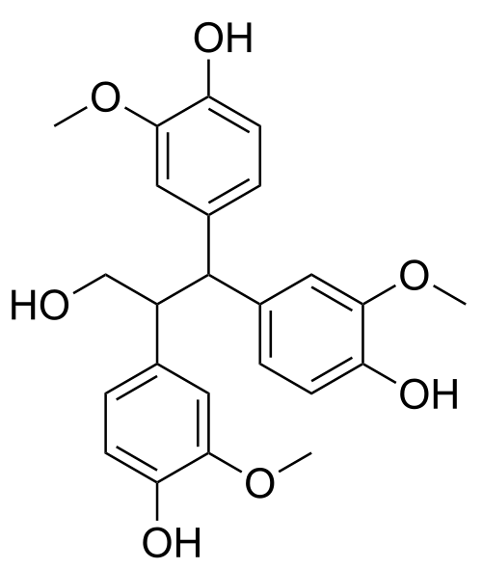
Notes:
Quebecol a novel phenol found only in processed maple syrup http://www.sciencedirect.com/science/article/pii/S1756464611000090

Slide 6
http://www.uvm.edu/~pmrc/research06.pdf
http://maple.dnr.cornell.edu/Ext/history_tree_imp.htm
http://maple.dnr.cornell.edu/Ext/quebec/2006Monograph.pdf
http://www.northamericanmaple.org/index.php/en/namsc-research-fund
http://www.northamericanmaple.org/images/stories/CropReport/2011USMapleCrop.pdf
http://www.statcan.gc.ca/pub/23-221-x/23-221-x2010000-eng.pdf

Slide 7
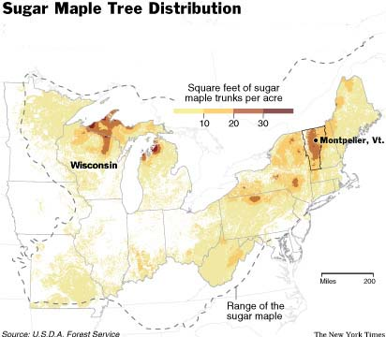
Notes:
I notice a lake effect in the distribution, but does temperatures effect sap volumes?

Slide 8
Protocol equipment needs
http://www.bonterrabees.com/hivecaseoptions.html
http://www.bonterrabees.com/doityourselfplans.html
http://www.honeyrunapiaries.com/observationhive.phtml
http://www.honeyrunapiaries.com/beekeeping_plans.phtml
http://www.draperbee.com/catalog/page7.htm#OBSERVATION HIVES

Slide 9
http://www.beesource.com/build-it-yourself/3-frame-observation-hive-2/
http://www.honeytraveler.com/single-flower-honey/honeydew-or-forest-honeys/

Slide 10
Veteran owned business owns protocol equipment but on long term loan to community college partner
Veteran owned small business contracts with college maintenance to build protocol equipment to benefit the college and instill a entrapernural spirit in students and maintenance employees*
College deploys observation hives in science museum and college science classrooms to instill an interest in social insects and economics of social insect products.
College deploys hives on college rooftops
Notes:
*Veteran owned concern hires employees to build and sell observation hives to government and agriculture

Slide 11
College agrees to plant and research sugar maples on campus utilizing cuttings from agriculture research stations
The college agrees to plant clover and other nitrogen fixing cover crops that produce forage for bees
The city of Port Huron agrees to plant clover around sidewalk trees
The city of Port Huron agrees to plant sugar maples as opportunity and funding arises, and to utilize the agricultural research programs trees.
Notes:
Nitrogen fixing improves health of city trees and provides food for college roof top bees

Slide 12
The city of Port Huron agrees to conduct with the college and the veteran owned concern a survey of city and privately owned maple trees
Research to be done on a tree leasing scheme to the veteran owned concern for sap production

Slide 13
A proposed Aphid domestication experiment protocol
Experiment with several natural or artificial substrates that mimic plant exoderm and Xylem and create a flow of sugar maple or other sap fluids.
Entice bees to consume and produce honey.
Compare the economics of this process to the expense of boiling sap to produce syrup.

Slide 14
College will consider,
Student and employee involvement in research programs , to include honors, food based microbiology options, faculty sponsorship of the above ideas
The veteran owned concern will consider employment and employee ownership of any ideas that received help in development

